Slide 1
GARBAGE COLLECTIONS

Slide 2
What is Garbage Collection process in java?
GC (Garbage collection) is the process by which JVM cleans objects (unused objects) from heap to reclaim heap space in java.
What is Automatic Garbage Collection in JVM heap memory in java?
Automatic garbage collection is the process of
Identifying objects which are in use in java heap memory and
Which objects are not in use in java heap memory and
deleting the unused objects in java heap memory.
What is Throughput in gc(garbage collection) in java ?
Throughput is the time not spent in garbage collection (GC) ( in percent).
Examples of how throughput might be measured include >
The number of transactions completed in a given time.
The number of jobs that a batch program can complete in an hour.
The number of database queries that can be completed in an hour.

Slide 3
What is Stop the World Event?
All the non-daemon threads running in application are stopped during minor garbage collections (i.e. the application stops for while).
Major garbage collection occurs in Old Generation

Slide 4
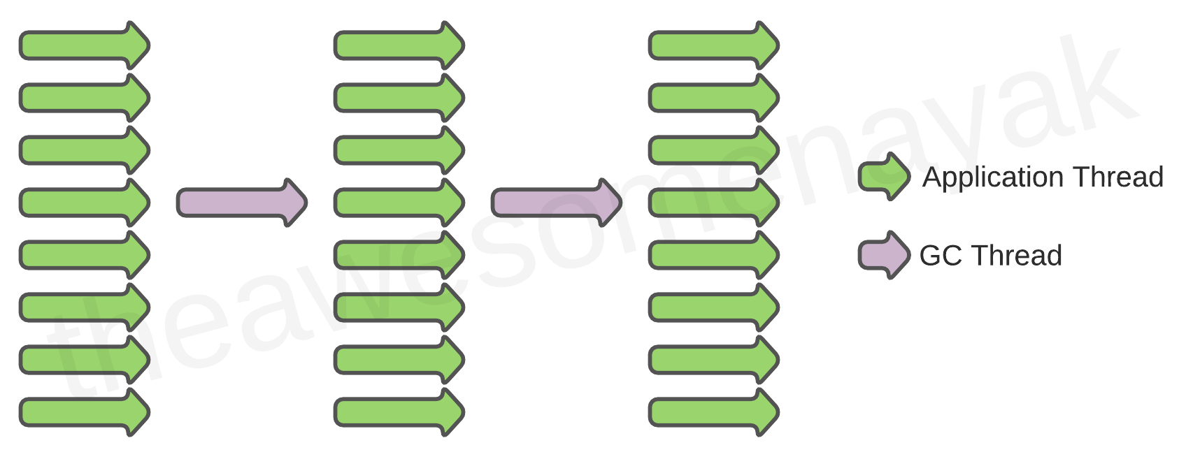
Serial GC
All garbage collection events are conducted serially in one thread. Compaction is executed after each garbage collection.
When it runs, it leads to a "stop the world" event where the entire application is paused. Since the entire application is frozen during garbage collection, it is not recommended in a real world scenario where low latencies are required.

Slide 5
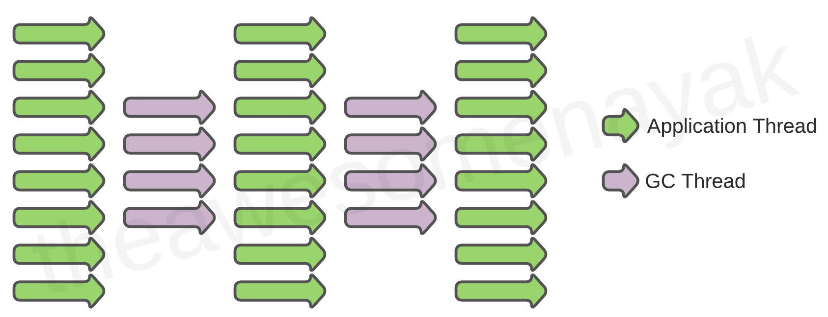
Parallel GC
The parallel collector is intended for applications with medium-sized to large-sized data sets that are run on multiprocessor or multithreaded hardware. This is the default implementation of GC in the JVM and is also known as Throughput Collector.
Multiple threads are used for minor garbage collection in the Young Generation. A single thread is used for major garbage collection in the Old Generation.
Running the Parallel GC also causes a "stop the world event" and the application freezes.

Slide 6
Parallel Old GC
This is the default version of Parallel GC since Java 7u4. It is same as Parallel GC except that it uses multiple threads for both Young Generation and Old Generation.

Slide 7
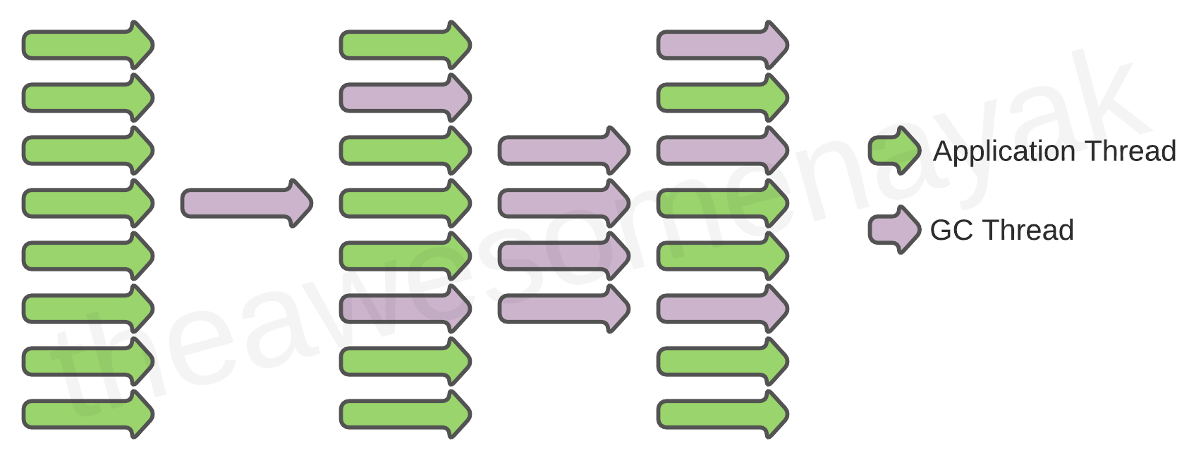
CMS (Concurrent Mark Sweep) GC
This is also known as the concurrent low pause collector. Multiple threads are used for minor garbage collection using the same algorithm as Parallel. Major garbage collection is multi-threaded, like Parallel Old GC, but CMS runs concurrently alongside application processes to minimize “stop the world” events.
Because of this, the CMS collector uses more CPU than other GCs. If you can allocate more CPU for better performance, then the CMS garbage collector is a better choice than the parallel collector. No compaction is performed in CMS GC.

Slide 8
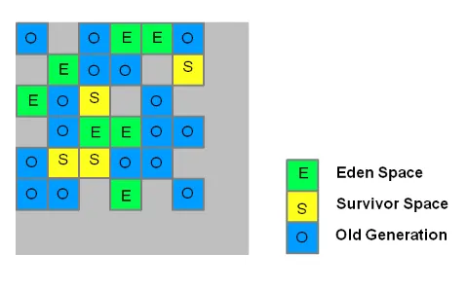
G1 (Garbage First) GC
Garbage first (G1) was meant to replace CMS. G1 GC is parallel, concurrent, and incrementally compacting, with low pause-time. G1 uses a different memory layout than CMS, dividing the heap memory into equal sized regions.
There are three main types of regions in G1:
Eden: This is where newly created objects are allocated.
Survivor: There are typically two Survivor regions (S0 and S1), and they are used to hold objects that have survived one or more garbage collection cycles.
Old Generation: This region is used to hold long-lived objects that have survived multiple garbage collection cycles.

Slide 9
G1 (Garbage First) GC
Initial Mark:
G1 starts with an initial marking phase. During this phase, it identifies the live objects in the old generation and marks them as such. This phase is done concurrently with the application threads, so it has minimal impact on application performance.
Concurrent Marking:
After the initial mark, G1 performs a concurrent marking phase to identify more live objects in all regions of the heap. This phase runs concurrently with the application threads, allowing the application to continue executing.
Remark:
Once concurrent marking is completed, G1 performs a remark phase to identify any objects that may have been modified since the initial marking. This ensures accuracy in determining live objects. This phase may cause a brief pause in application execution.

Slide 10
G1 (Garbage First) GC
Concurrent Cleanup:
After the remark phase, G1 performs concurrent cleanup, which involves reclaiming memory from regions that are no longer in use. This is done concurrently with the application threads.
Evacuation:
G1 uses a process called “evacuation” to move live objects from one region to another. It selects regions with the most garbage (hence the name “Garbage-First”) and prioritizes them for evacuation. The goal is to empty regions with a lot of garbage to minimize fragmentation and improve overall heap utilization.

Slide 11
G1 (Garbage First) GC
Mixed Garbage Collection:
G1 uses a concept called “mixed garbage collection” to perform garbage collection on both the young generation (Eden and Survivor regions) and the old generation. This allows G1 to achieve better overall heap utilization and avoid long pause times associated with full garbage collections.

Slide 12
Epsilon GC
Epsilon is a no-operation (no-op) garbage collector (GC) that was introduced in Java 11. Epsilon just manages memory allocation. It doesn’t do any actual memory reclamation. This means that once the available Java heap is exhausted, the JVM will shut down.
Epsilon GC can be used to measure the performance of other garbage collectors. It can also be used for applications that have very low latency requirements and can tolerate the risk of the JVM shutting down if the heap is exhausted.
It is important to note that Epsilon GC is still an experimental feature, and it is not recommended for use in production environments.

Slide 13
Shenandoah gc
Shenandoah is a low-latency garbage collector (GC) that was released in JDK 12. It is designed to reduce GC pause times by performing more garbage collection work concurrently with the running Java program.

Slide 14
zgc java
Shenandoah is a low-latency garbage collector (GC) that was released in JDK 12. It is designed to reduce GC pause times by performing more garbage collection work concurrently with the running Java program.
ZGC, or Z Garbage Collector, is a low-latency garbage collector that was introduced in Java 11. It is designed to be scalable and can handle heaps ranging from 8MB to 16TB in size, with sub-millisecond maximum pause times. ZGC is a concurrent, region-based garbage collector that uses a mark-sweep-compact algorithm. It is designed to minimize the impact of garbage collection on application performance by performing most of its work concurrently with the application threads.

